Slide 1
Modelling and control of Turbocharged SI engine
Team 2
Ameya Salvi
Sohan Nair
Pardha Sai Krishna A

Slide 2
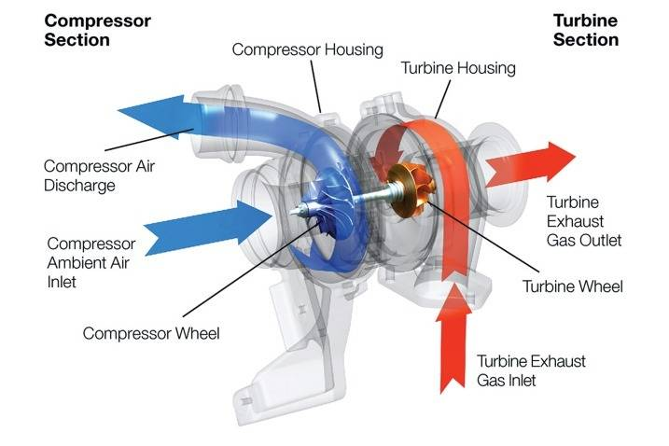
What ?
Fig 1: Turbocharger representative diagram
https://media.ed.edmunds-media.com/non-make/carbuying/carbuying_501141_717.jpg
2

Slide 3
Our Approach
Mean Value Engine Models (MVEMs)
Using a two input single output (TISO) system, we will control the throttle and wastegate using a single input variable.
A PI controller is used since the wastegate is a slow actuator and overshoot is not a concern
3

Slide 4
Fuel Optimal Approach
Maximum fuel efficiency is achieved at a given operating point when the wastegate is as open as possible
This minimizes pumping losses
The wastegate is open at low and medium loads, only closing at WOT
Only one actuator is active, though it has slow response
4

Slide 5
Mean Value Modelling
Mean value models are control oriented models which assumes the process to be spread over the entire cycle
By mean value modelling, every component will be treated as Volumetric pump
The reciprocating behavior of engine is identified by introducing delays
Mean value models consider variables to spatially invariant
Ref: Guzzella, L., & Onder, C. (2009). Introduction to modeling and control of internal combustion engine systems. Springer Science & Business Media.
5

Slide 6
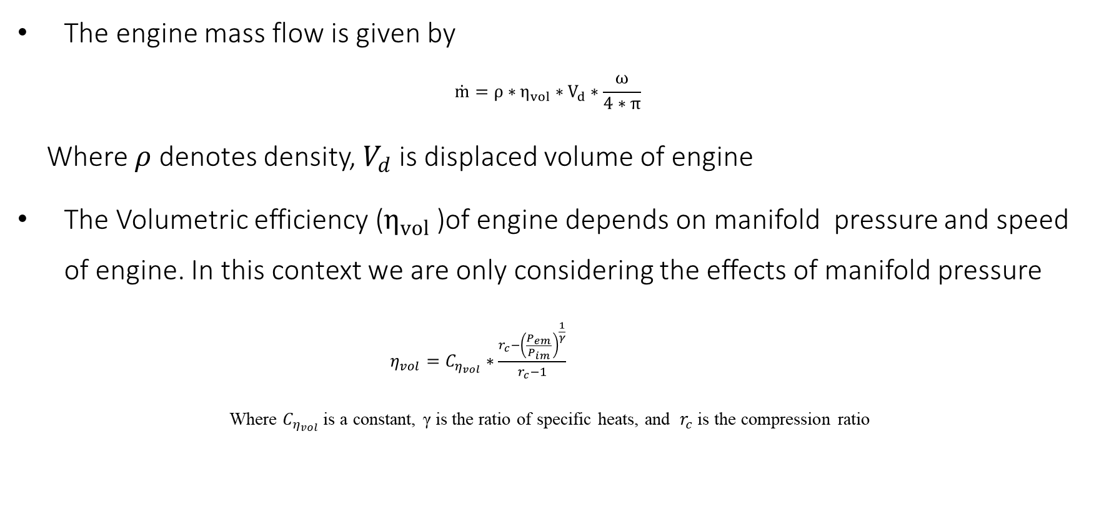
Engine mass flow model
The engine mass flow is given by
$$\dot{m}=ρ∗η_{vol}∗V_{d}∗\frac{ω}{4∗π}$$
Where $ρ$ denotes density, $V_{d}$ is displaced volume of engine
The Volumetric efficiency ($η_{vol}$)of engine depends on manifold pressure and speed of engine. In this context we are only considering the effects of manifold pressure
$η_{vol}=C_{η_{vol}}∗\frac{r_{c}−{\left(\frac{P_{em}}{P_{im}}\right)}^{\frac{1}{γ}}}{r_{c}−1}$
Where $C_{η_{vol}}$ is a constant, γ is the ratio of specific heats, and $r_{c}$is the compression ratio
Ref: Guzzella, L., & Onder, C. (2009). Introduction to modeling and control of internal combustion engine systems. Springer Science & Business Media.
6

Slide 7
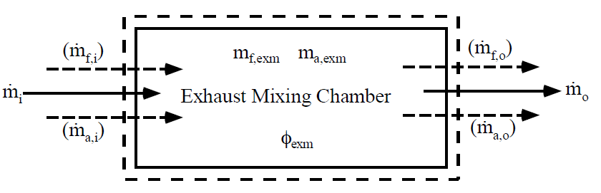
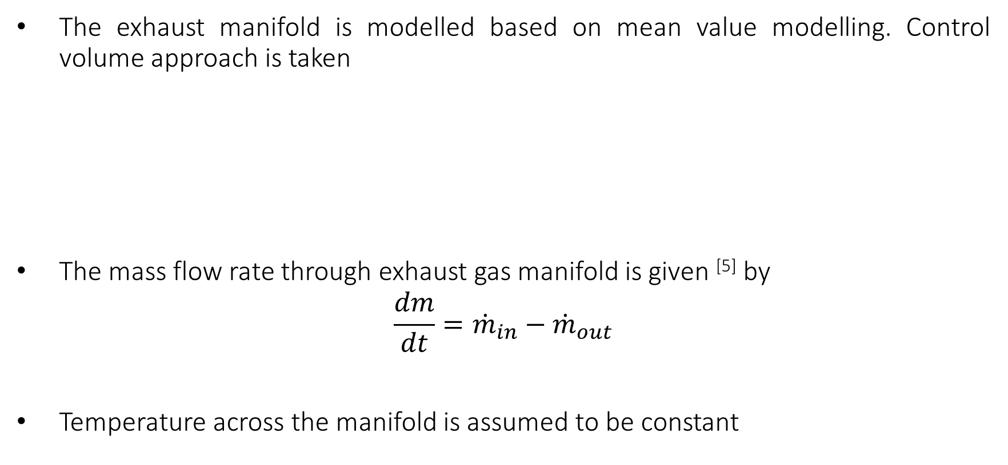
Exhaust manifold model
The exhaust manifold is modelled based on mean value modelling. Control volume approach is taken
The mass flow rate through exhaust gas manifold is given ^{[5]} by
$$\frac{dm}{dt}={\dot{m}}_{in}−{\dot{m}}_{out}$$
Temperature across the manifold is assumed to be constant
Fig 2: Control volume of Exhaust manifold
Ref: Eriksson, L., Nielsen, L., Brugård, J., Bergström, J., Pettersson, F., & Andersson, P. (2002). Modeling of a turbocharged SI engine. Annual Reviews in Control, 26(1), 129-137.
7

Slide 8
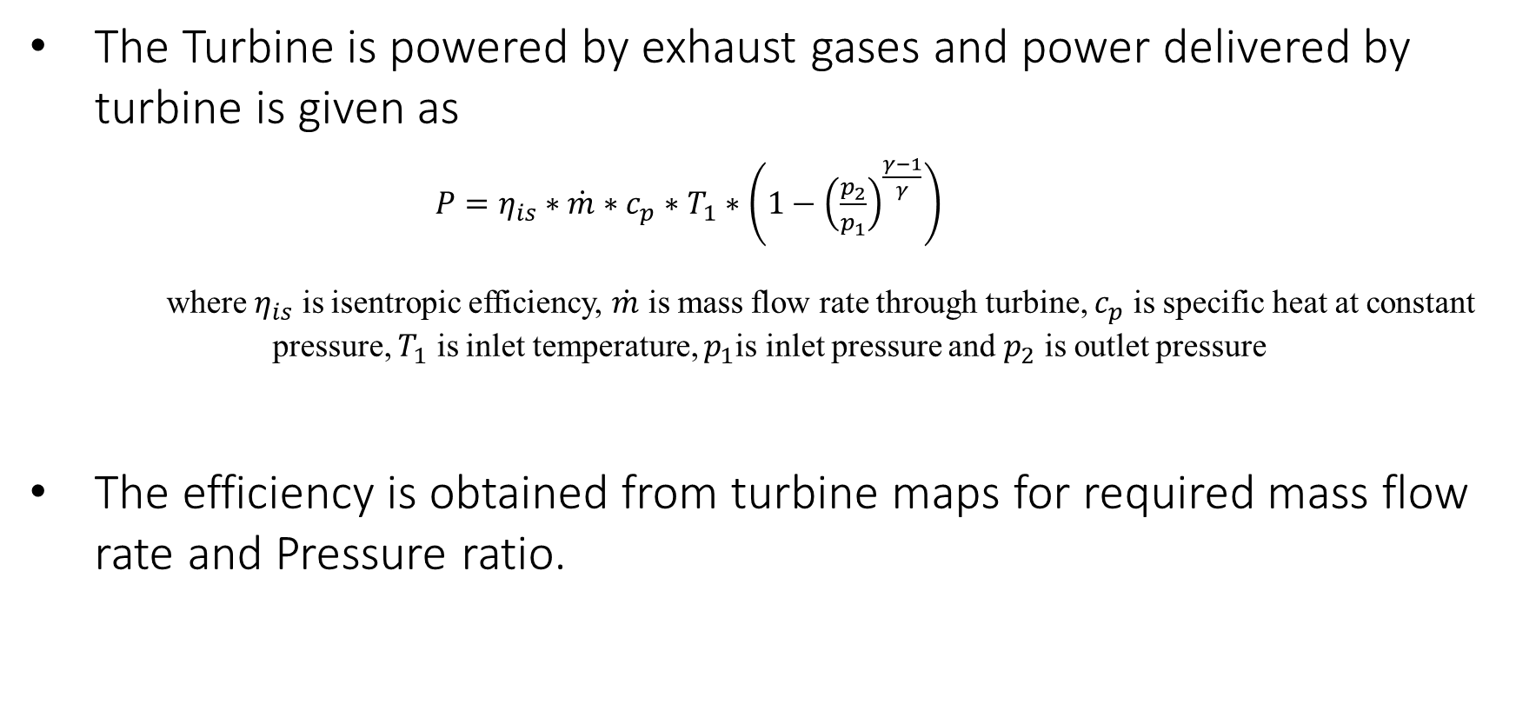
Turbine model
The Turbine is powered by exhaust gases and power delivered by turbine is given as
$P=η_{is}∗\dot{m}∗c_{p}∗T_{1}∗\left(1−{\left(\frac{p_{2}}{p_{1}}\right)}^{\frac{γ−1}{γ}}\right)$
where $η_{is}$ is isentropic efficiency, $\dot{m}$ is mass flow rate through turbine, $c_{p}$ is specific heat at constant pressure, $T_{1}$ is inlet temperature, $p_{1}$is inlet pressure and $p_{2}$ is outlet pressure
The efficiency is obtained from turbine maps for required mass flow rate and Pressure ratio.
Ref: L. Eriksson, S. Frei, C. Onder, L. Guzzella, Control and optimization of turbocharged spark ignited engines, Proceedings of the IFAC 15th Triennial World Congress, 2002..
8

Slide 9
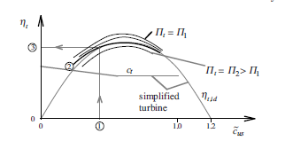
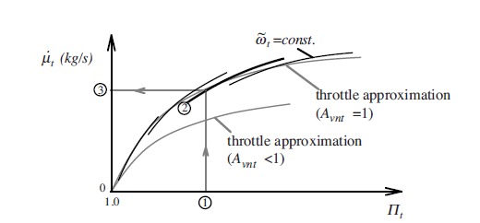
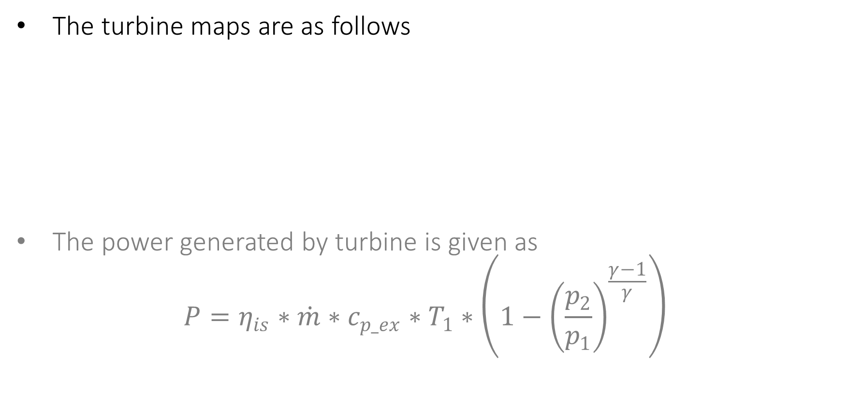
Turbine model
The turbine maps are as follows
The power generated by turbine is given as
$$P=η_{is}∗\dot{m}∗c_{p_ex}∗T_{1}∗\left(1−{\left(\frac{p_{2}}{p_{1}}\right)}^{\frac{γ−1}{γ}}\right)$$
Fig 3: Efficiency vs Blade speed ratio
Fig 4: Turbine maps
Ref: Ref: L. Eriksson, S. Frei, C. Onder, L. Guzzella, Control and optimization of turbocharged spark ignited engines, Proceedings of the IFAC 15th Triennial World Congress, 2002..
9

Slide 10
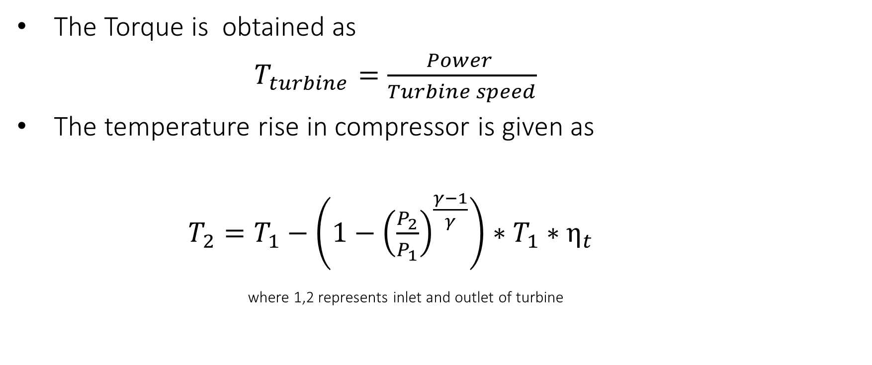
Turbine model
The Torque is obtained as
$T_{turbine}=\frac{Power }{Turbine speed}$
The temperature rise in compressor is given as
$T_{2}=T_{1}−\left({1−\left(\frac{P_{2}}{P_{1}}\right)}^{\frac{γ−1}{γ}}\right)∗T_{1}∗η_{t}$
where 1,2 represents inlet and outlet of turbine
Ref: Ref: L. Eriksson, S. Frei, C. Onder, L. Guzzella, Control and optimization of turbocharged spark ignited engines, Proceedings of the IFAC 15th Triennial World Congress, 2002..
10

Slide 11
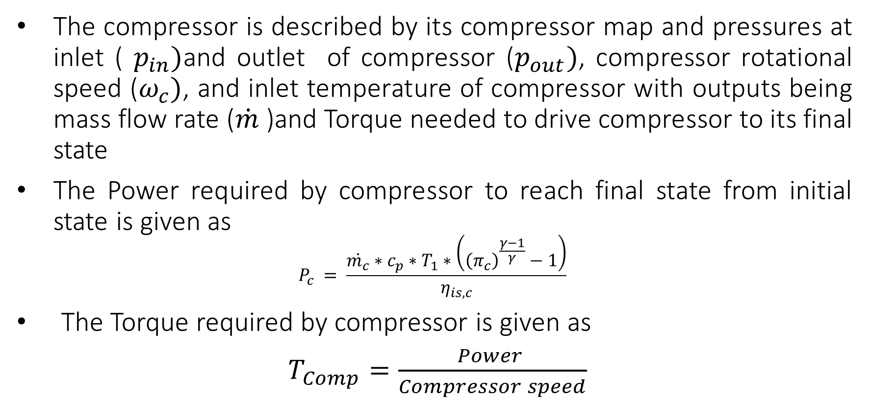
Compressor model
The compressor is described by its compressor map and pressures at inlet ( $p_{in})$and outlet of compressor ($p_{out})$, compressor rotational speed ($ω_{c})$, and inlet temperature of compressor with outputs being mass flow rate ($\dot{m}$ )and Torque needed to drive compressor to its final state
The Power required by compressor to reach final state from initial state is given as
$$P_{c} = \frac{\dot{m_{c}}∗c_{p}∗T_{1}∗\left({\left(π_{c}\right)}^{\frac{γ−1}{γ}}−1\right)}{η_{is,c}}$$
The Torque required by compressor is given as
$T_{Comp}=\frac{Power }{Compressor speed}$
Ref: Ref: L. Eriksson, S. Frei, C. Onder, L. Guzzella, Control and optimization of turbocharged spark ignited engines, Proceedings of the IFAC 15th Triennial World Congress, 2002..
11

Slide 12
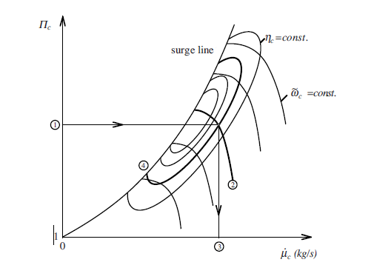
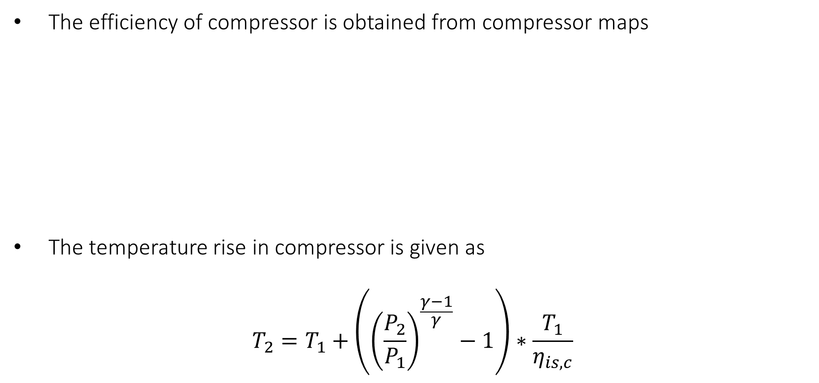
Compressor model
The efficiency of compressor is obtained from compressor maps
The temperature rise in compressor is given as
$$T_{2}=T_{1}+\left({\left(\frac{P_{2}}{P_{1}}\right)}^{\frac{γ−1}{γ}}−1\right)∗\frac{T_{1}}{η_{is,c}}$$
Fig 5: Compressor Maps
Ref: Ref: L. Eriksson, S. Frei, C. Onder, L. Guzzella, Control and optimization of turbocharged spark ignited engines, Proceedings of the IFAC 15th Triennial World Congress, 2002..
12

Slide 13
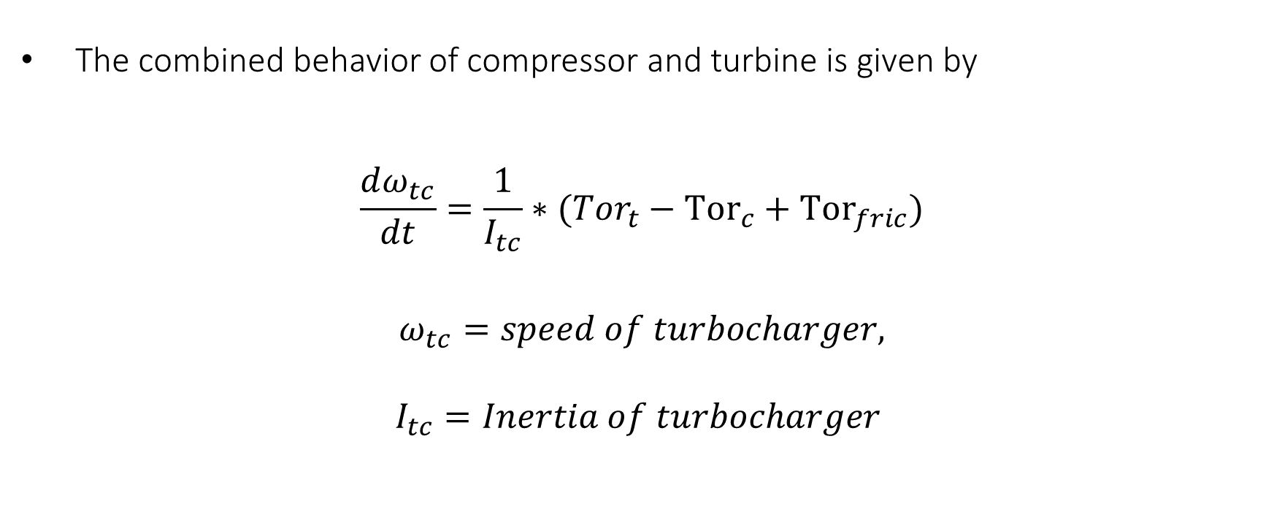
Turbocharger Dynamics
The combined behavior of compressor and turbine is given by
$$\frac{dω_{tc}}{dt}=\frac{1}{I_{tc}}∗({Tor}_{t}−{Tor}_{c}+{Tor}_{fric})$$
$$ω_{tc}=speed of turbocharger,$$
$$I_{tc}=Inertia of turbocharger$$
13

Slide 14
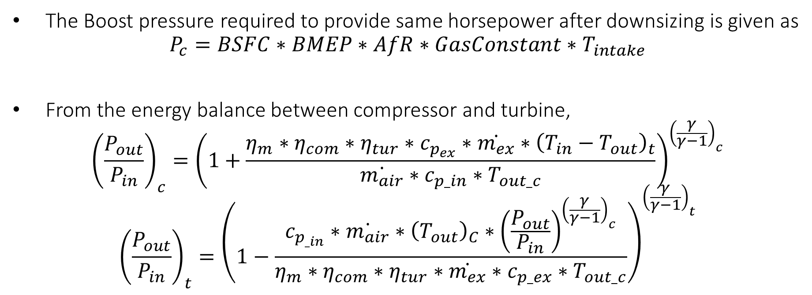
Boost Pressure estimation and energy Balance equation
The Boost pressure required to provide same horsepower after downsizing is given as
$$P_{c}=BSFC∗BMEP∗AfR∗GasConstant∗T_{intake}$$
From the energy balance between compressor and turbine,
$${\left(\frac{P_{out}}{P_{in}}\right)}_{c}={\left(1+\frac{η_{m}∗η_{com}∗η_{tur}∗c_{p_{ex}}∗\dot{m_{ex}}∗{\left(T_{in}−T_{out}\right)}_{t}}{\dot{m_{air}}∗c_{p_in}∗T_{out_c}}\right)}^{{\left(\frac{γ}{γ−1}\right)}_{c}}$$
$${\left(\frac{P_{out}}{P_{in}}\right)}_{t}={\left(1−\frac{c_{p_{_in}}∗\dot{m_{air}}∗{\left(T_{out}\right)}_{C}∗{\left(\frac{P_{out}}{P_{in}}\right)}^{{\left(\frac{γ}{γ−1}\right)}_{c}}}{η_{m}∗η_{com}∗η_{tur}∗\dot{m_{ex}}∗c_{p_ex}∗T_{out_c}}\right)}^{{\left(\frac{γ}{γ−1}\right)}_{t}}$$
http://www.turbos.borgwarner.com/go/B5WY8I
14

Slide 15
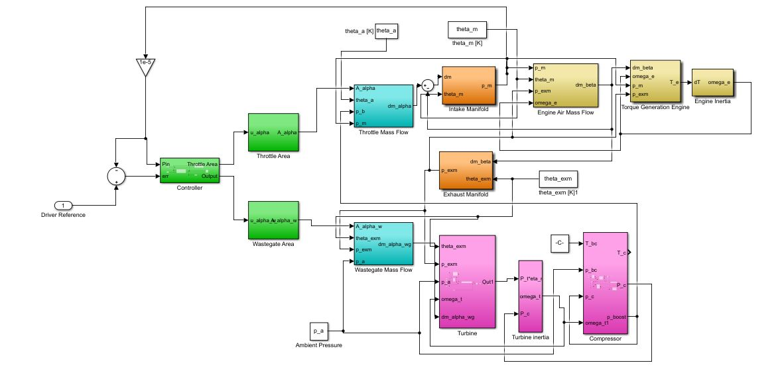
Simulink model
Fig 6
15

Slide 16
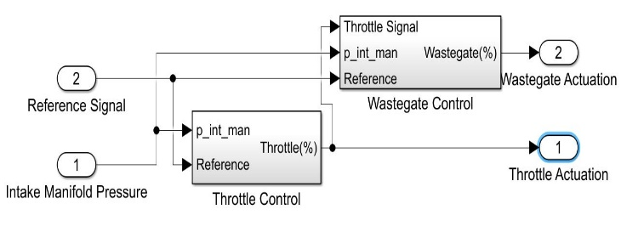
Coordinated Control Approach: Mid-Ranging
Mid-Ranging is a process control technique for coordinated controls of two actuators.
Coarse actuator has low resolution but higher output dominance
Trim actuator has higher resolution but saturates easily.
Usually one actuator is stationary when other is being operated.
Figure 7: Reference Block diagram for Coordinated control
16

Slide 17
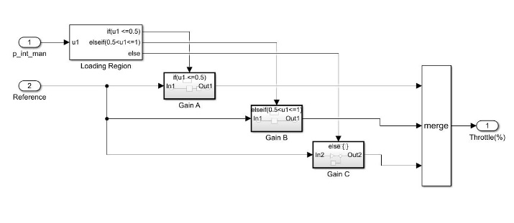
Controller Tuning: Mid-Ranging
Gain can be scheduled over a wide range of operating points.
Higher the operating points, better the performance will be of the controller.
We have chosen to tune the controller over three operating regions of low, medium and high loads.
Load | Throttle | Wastegate
High | PI | Open
Medium | PI | P
Low | PI | Closed
Figure 8: Reference Block diagram for scheduling Throttle gains with If-Else logic
Table 1: Actuation Control over load regions
17

Slide 18
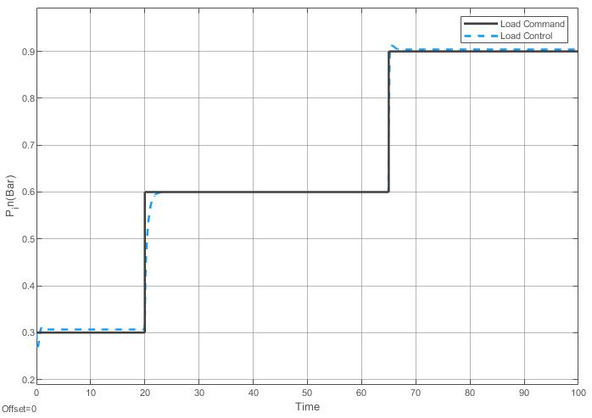
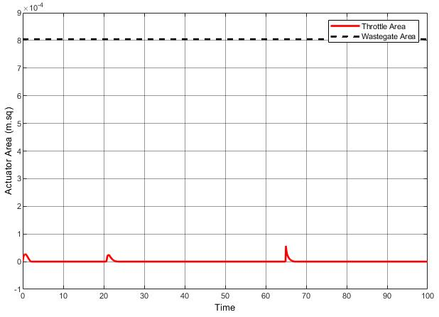
Controllability Verification for the Fuel optimum approach
It is first essential to check the controllability of the fuel optimum approach.
The controller was tested for reference tracking of intake pressure with the wastegate completely open.
Figure 9: Verification of the Fuel optimum controllability
18

Slide 19
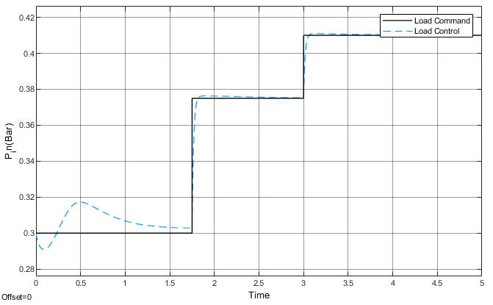
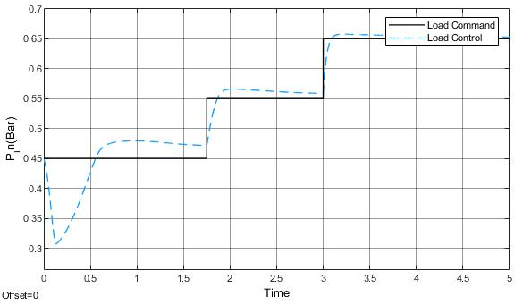
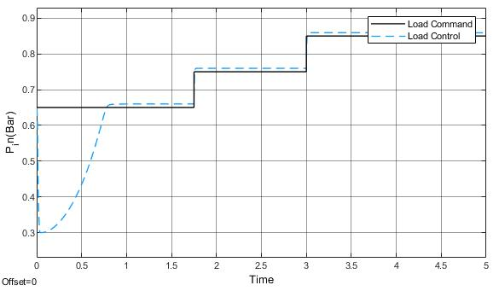
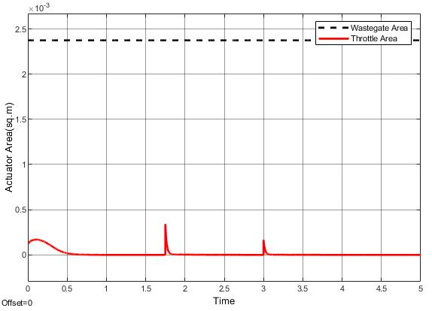
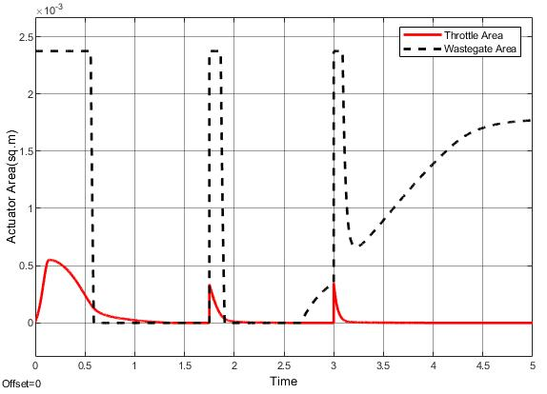
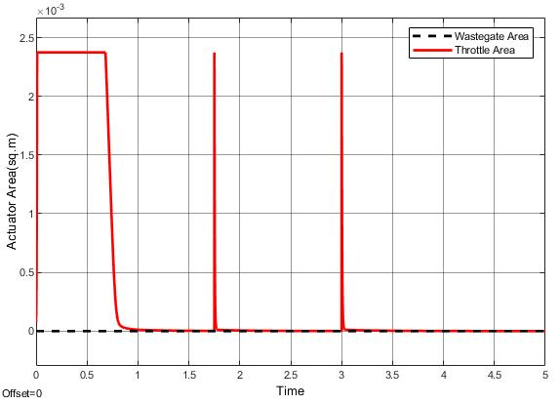
Reference tracking and Actuations for multiple load cases
0.3 bar ~ 0.5 bar
0.4 bar ~ 0.7 bar
0.65 bar ~ 0.9 bar
Figure 10
19

Slide 20
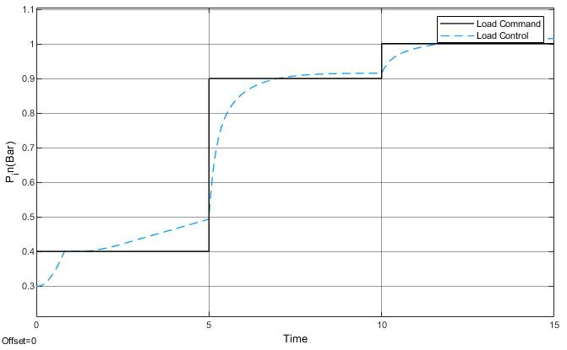
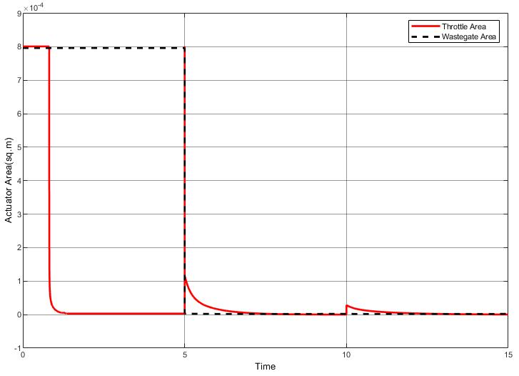
Coordinated Control
Coordinated control for throttle and wastegate was demonstrated over for reference tracking of Intake Manifold pressure over a range of 0.3 bar to 0.9 bar pressure.
A maximum lag of 1.5 Seconds was observed when transitioning from the low to high load conditions.
It was observed that the controller performance can be improved by increasing the number of operating points and scheduling the gains over all operating regions.
Figure 11: Coordinated Control of throttle and wastegate
20

Slide 21
References
[1] Guzzella, L., & Onder, C. (2009). Introduction to modeling and control of internal combustion engine systems. Springer Science & Business Media.
[2] Yu Guang and K. Suzuki, “Application of control-oriented modeling methodology to turbocharged SI engine system development,” 2014, pp. 189–194 [Online]. Available: https://ieeexplore.ieee.org/document/6896620
[3] A. F. Khan, A. Burluka, J. Neumeister, D. OudeNijeweme, P. Freeland, and J. Mitcalf, “Combustion and Autoignition Modelling in a Turbocharged SI Engine,” vol. 9, no. 4, pp. 2079–2090, Oct. 2016 [Online]. Available: https://www.jstor.org/stable/26284968
[4] R. Sharma, D. Nesic, and C. Manzie, “Control Oriented Modeling of Turbocharged (TC) Spark Ignition (SI) Engine,” Apr. 2009 [Online]. Available: https://saemobilus.sae.org/content/2009-01-0684
[5] Q. Chen, J. Ni, X. Shi, Q. Wang, Q. Chen, and S. Liu, “Research on Effect of Wastegate Diameter on Turbocharged Gasoline Engine Perfor mance,” Apr. 2016 [Online]. Available: https://saemobilus.sae.org/content/2016-01-1028
[6] W. Hofbauer, P. Dolovai, H. . Joergl, and J. Hirzinger, “LQG/LTR Controller Design for a Gas Engine,” 2006, vol. 3, pp. 1631–1636 [Online]. Available: https://ieeexplore.ieee.org/document/4078488
21

Slide 22
References
[7] R. Beckmann, W. Drewelow, B. Lampe, P. Dunow, M. Schultalbers, and N. Weinhold, “Exact air charge feed forward control of a turbocharged SI engine,” 2012, pp. 1509–1515 [Online]. Available: https://ieeexplore.ieee.org/document/6402698
[8] L. Eriksson, L. Nielsen, J. Brugård, J. Bergström, F. Pettersson, and P. Andersson, “Modeling of a turbocharged SI engine,” vol. 26, no. 1, pp. 129–137, 2002 [Online]. Available: https://www.sciencedirect.com/science/article/pii/S1367578802800220
[9] D. Khiar, J. Lauber, T. . Guerra, T. Floquet, Y. Chamaillard, and G. Colin, “Nonlinear modelling and control approach for a turbocharged SI engine,” 2006, pp. 325–330 [Online]. Available: https://ieeexplore.ieee.org/document/4153442
[10] L. Eriksson, S. Frei, C. Onder, L. Guzzella, Control and optimization of turbocharged spark ignited engines, Proceedings of the IFAC 15th Triennial World Congress, 2002.
[11] P. Gorzelic, E. Hellstrom, A. Stefanopoulou, L. Jiang, S. Gopinath, A Coordinated Approach for Throttle and Wastegate Control in Turbocharged Spark Ignition Engines, ACCESS project consortium (Robert Bosch LLC, AVL Inc., Emitec Inc.)
22

Slide 23
References
[12] A. Thomasson, L. Eriksson, O. Leufv´en, P. Andersson, Wastegate Actuator Modeling and Model-Based Boost Pressure Control, IFAC Workshop on Engine and Powertrain Control, Simulation and Modelling, 2009.
23

Slide 24
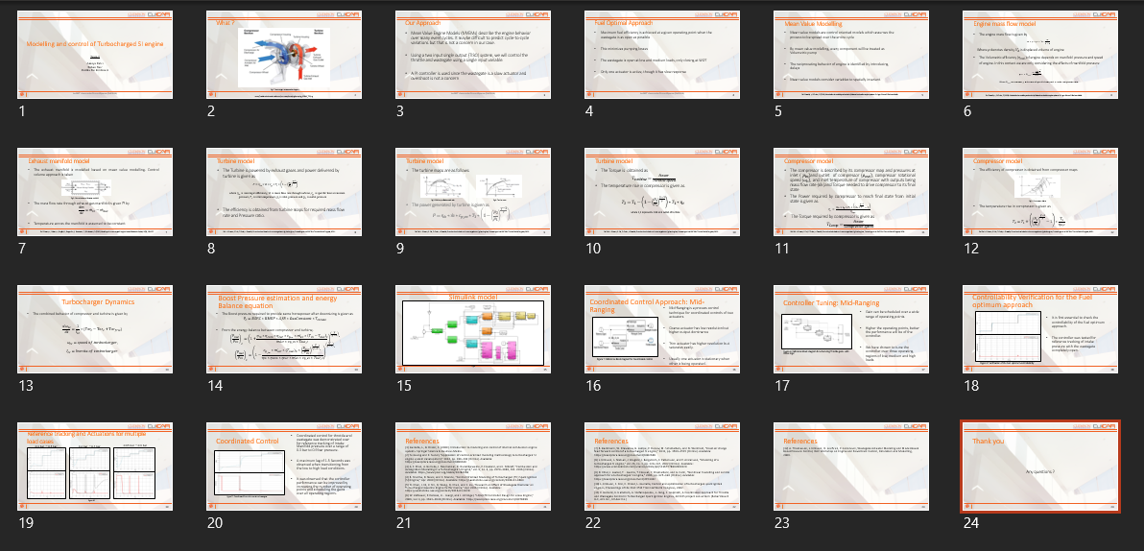
Thank you
24

